Slide 1

Student management system

Slide 2
Abstract
1. Purpose and Goals
Streamline the management of student data and activities.
Improve administrative efficiency and reduce manual errors.
2. Key Features
Student Records: Centralized database to manage student details (personal, academic, and extracurricular).
Attendance Tracking: Automated tracking and reporting of student attendance.
Grade Management: Record, calculate, and display grades for assignments, exams, and overall performance.
3. Security and Privacy
Ensure data security with encryption, role-based access control, and compliance with data protection laws.
Regular backups and disaster recovery mechanisms.

Slide 3
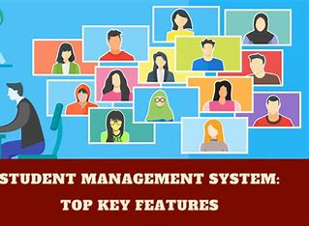
Introduction
1. Purpose of a Student Management System:
To enhance the efficiency and accuracy of managing student-related data.
To streamline administrative tasks and reduce manual effort.
2. Core Objectives:
Improve the accessibility and organization of student information.
Ensure real-time communication and transparency between all stakeholders.
3. Importance in Education:
Reduces paperwork and administrative overhead.
Enhances the overall management of academic and extracurricular activities

Slide 4
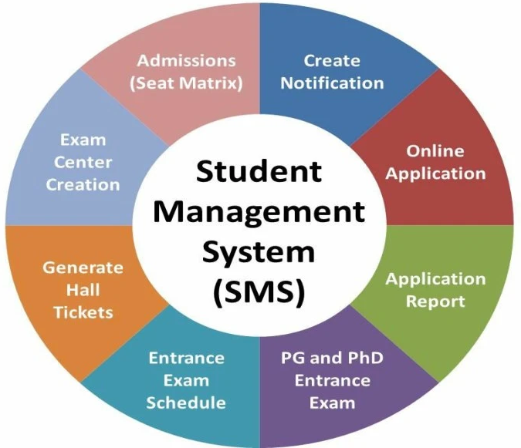
Benefits
1. Streamlined Administration
Simplifies the management of student records, attendance,
fees, and academic performance.
Reduces manual workload for administrative staff.
2. Enhanced Data Accuracy and Organization
Eliminates errors caused by manual data entry.
Centralized storage ensures all student-related information is up-to-date and easily accessible.
3. Improved Communication
Facilitates real-time communication between students, parents, teachers, and administrators through notifications, emails, or SMS.

Slide 5
Objectives
Track student performance through grades, assignments, and progress reports.
Provide insights into academic strengths and weaknesses for better support.
Record and monitor student attendance in real-time.
Generate reports for absences or irregularities to address issues promptly.
Offer a user-friendly interface for students, teachers, and administrators.
Provide multi-device access (desktop, mobile, and tablets) for convenience

Slide 6
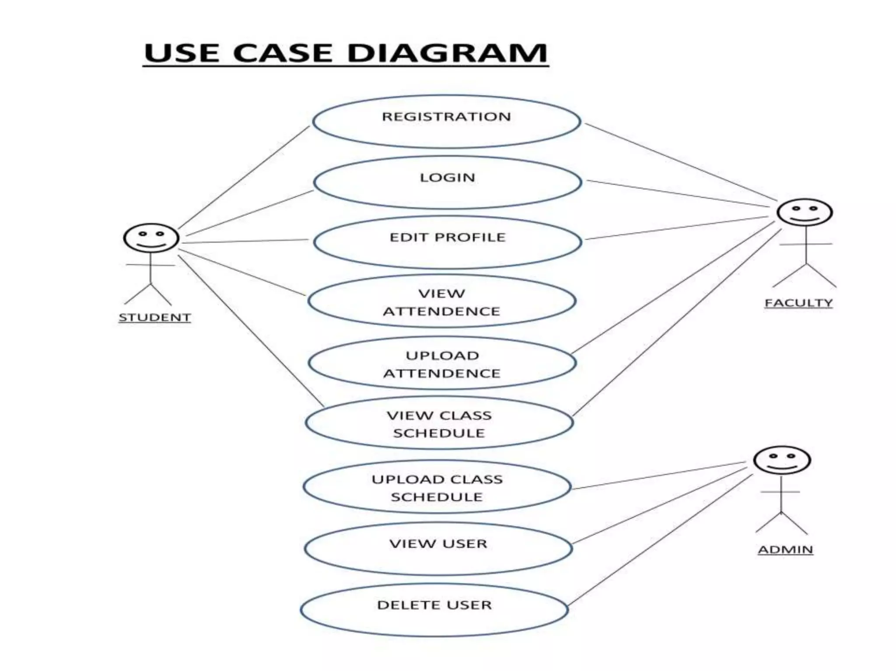
Use case diagram

Slide 7
Conclusion
The system automates repetitive tasks, reducing manual errors and improving the accuracy of data management.
With cloud-based and centralized systems, users can access information anytime, anywhere, making it adaptable to growing institutional needs.
It facilitates seamless interaction between students, teachers, and administrators, fostering a more collaborative environment.
Modern SMS ensures that student information is safeguarded against unauthorized access with robust security measures.

Slide 8


